Slide 1

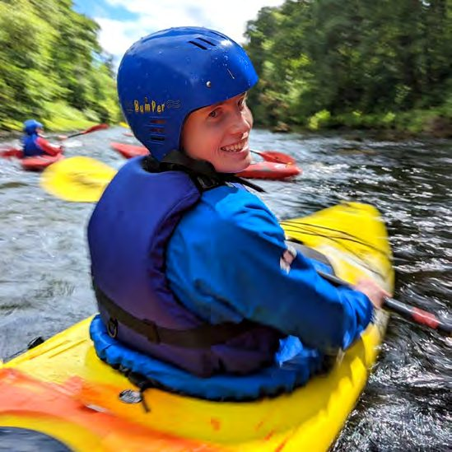
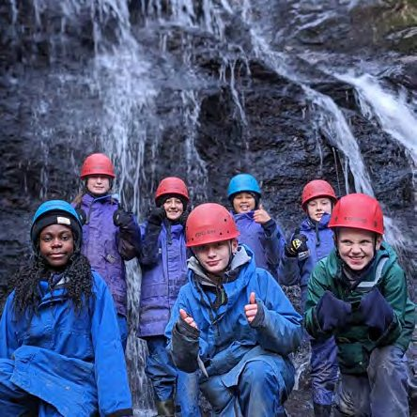
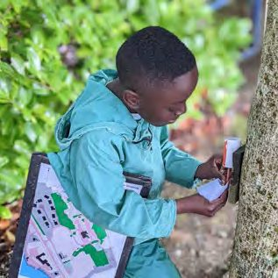
BLAIRVADACH
OUTDOOR EDUCATION SERVICE
OUR
VALUES
2026
Notes:
Our values — Blairvadach Outdoor Education Service, 2026.

Slide 2
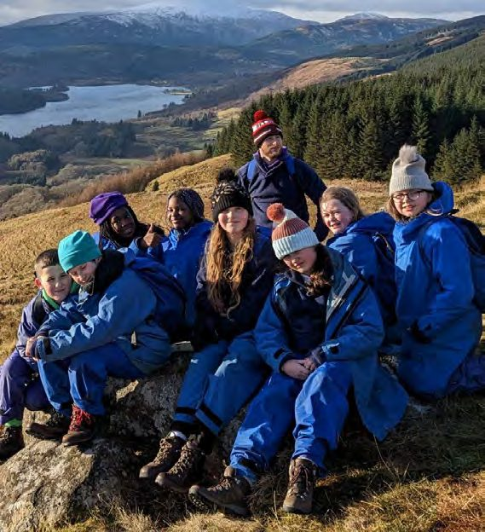
Our Vision
We are Glasgow’s Outdoor Education Service, inspiring young people to explore, grow and thrive.
We create transformative outdoor experiences that connect young people with place and build their confidence and skills. As the outdoor arm of Glasgow’s education service, we provide opportunities for young people, families, and partners across Glasgow’s communities to learn and grow in the outdoors.
Our aim is to remove barriers to learning and, in doing so, deliver sector-leading experiential learning that allows all young people to feel they belong and offers authentic outdoor experiences that translate into everyday life.
By putting nurture, trust, equity and ambition at the heart of everything we do, we play our part in making Glasgow a world-class learning city — and in making the outdoors a classroom open to all.
“We are Glasgow’s outdoor education service, and our classroom is the outdoors.”
Blairvadach Outdoor Education Service | Our Values

Slide 3
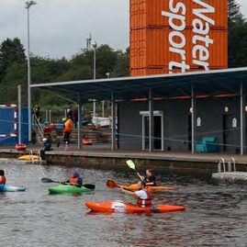
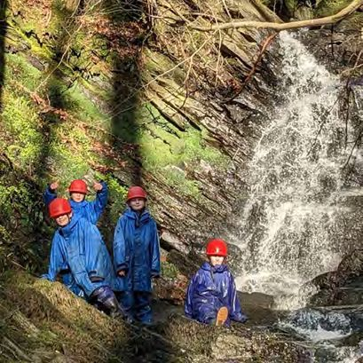
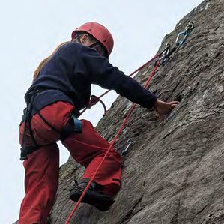
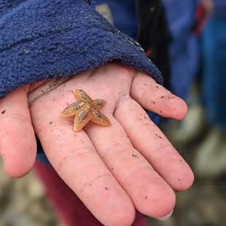
One Service, four teams
Together, these teams deliver the Service’s vision.
Pinkston Basin
Residential Team
DofE Glasgow
Care Experience
Removes social barriers by bringing nature-based, adventurous experiences to the heart of the city — through the Glasgow Urban Adventure Award and national qualifications, right on the doorstep of young people’s communities.
For over 50 years, giving young people the time and space to step out of their comfort zones, stay away from home, be challenged, and discover strengths they did not know they had — supporting the move from primary to secondary.
Takes our vision into every secondary school in Glasgow, building the network of coaches and coordinators that puts a nationally recognised award within reach of every young person, whatever their background.
Offers a relationship, a place to be, and a reason to grow — working one-to-one and in small groups with care-experienced young people alongside Glasgow’s Virtual School and Social Work.
Access and connection
Immersion and transformation
Opportunity for all
Nurture and equity
Blairvadach Outdoor Education Service | Our Values

Slide 4







Our Values
Seven values, lived two ways: in how we work with each other, and in how we work with young people.
We work to a high standard, and we share the why
Fun, growth and safe risk-taking
It’s never a no, it’s a how
We say it as it is, and share what matters
We grow by ourselves and with others
Same standard, same information, same kit
We work across boundaries and teams
In our work together
In our relationship with young people
How we treat each other as colleagues across all four teams — the standards we hold, the space we make, and the way we share what we know.
How we show up for the young people we work with — what we explain, what we expect, and how we make sure everyone can take part.
Blairvadach Outdoor Education Service | Our Values

Slide 5
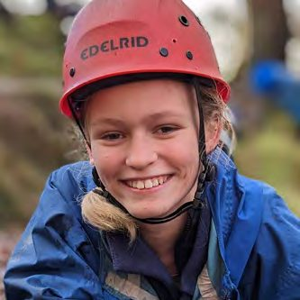
VALUE 01
Trust
We trust each other to work to a high standard — and we share the why with young people before every activity.
HOW IT SHOWS UP IN OUR WORK TOGETHER
HOW IT SHOWS UP IN OUR RELATIONSHIP WITH YOUNG PEOPLE
We trust each other to work to a high standard…which means:
We share the why with young people before every activity…which means:
We readily explain our thinking for our chosen activities and plans, and trust different methods
We see things that need doing and do them
We are given space to act and make space for others to act
We share when things go wrong
We respect each other’s qualifications and experience
We give young people accountability and space to learn
We trust young people within safe boundaries, allowing them to learn from failure safely We help young people build a culture of trust in themselves and their team
We share our thinking and reasoning with young people, so that they know what we are doing and why changes are made, so that they can learn with us
IN PRACTICE
IN PRACTICE
We trust that staff will take care of their areas of responsibility. This could mean maintaining equipment in good order at the residential centre. Trusting each other to get it done on time at Pinkston Basin. Or sharing the load and information on students and schools for the DofE and Care Experience teams.
We show up for young people, explaining our decisions and the choices made. This means that Care Experience staff are there every week to deliver for the young people in their programme. The staff explain changes in plans during the evening recap at the Residential Centre. DofE teams are honest about how young people are progressing and what they need to do to make progress in the award.
Blairvadach Outdoor Education Service | Trust
Notes:
Trust: We trust each other to work to a high standard — and we share the why with young people before every activity.

Slide 6
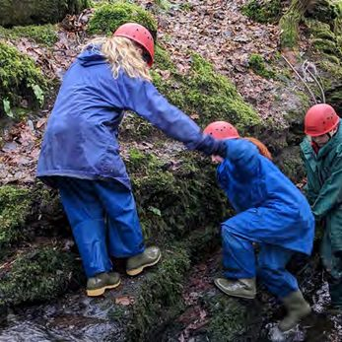
VALUE 02
Nurture
We have fun and support each other to grow — and we make it safe for young people to take risks.
HOW IT SHOWS UP IN OUR WORK TOGETHER
HOW IT SHOWS UP IN OUR RELATIONSHIP WITH YOUNG PEOPLE
We have fun and support each other to grow and develop…which means:
We support young people to have fun and support them to manage risks in a safe (physical and mental) environment…which means:
We understand the activities we ask young people to undertake and are knowledgeable about how they support young people to grow
We use regular meetings and check-ins as safety touchpoints
We create a safe environment (physically and mentally) in our interactions with colleagues and students to promote individual growth
We seek out and provide space for shared learning
We acknowledge that young people today face new challenges — “more anxious, more mental health issues, less likely to give stuff a go” — and we adapt our approach accordingly
We openly acknowledge to the student that not all students will love every activity, and we normalise differences
We find ways to cater for individual needs to promote learning and allow all young people to participate
IN PRACTICE
IN PRACTICE
We use regular meetings and interactions to create opportunities to share learning. For DofE, this might happen during the weekly meeting, while the Residential Team, Pinkston Basin, and Care Experience teams find ways to provide peer learning and mentoring support to one another as part of their professional development.
Across our service, we proactively plan for different abilities and seek to normalise different reactions and abilities across the activities our young people undertake.
Blairvadach Outdoor Education Service | Nurture
Notes:
Nurture: We have fun and support each other to grow — and we make it safe for young people to take risks.

Slide 7
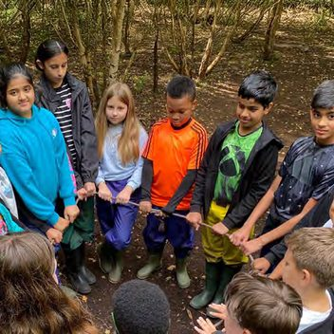
VALUE 03
Inclusion
We engage across our teams whatever the role — and we welcome and include all young people in our services.
HOW IT SHOWS UP IN OUR WORK TOGETHER
HOW IT SHOWS UP IN OUR RELATIONSHIP WITH YOUNG PEOPLE
We look for ways to engage within and across our team, regardless of role…which means:
We will welcome and include all young people in our services…which means:
We create opportunities for staff from different teams to learn from each other
We ensure that communication, planning and review meetings allow for a good exchange of information and help bring all staff onto the same page
It’s never a no, it’s a how (about creating options) — we work with teachers, parents and students to ensure everyone gets a great and equally enjoyable experience
We find ways to bridge gaps between different groups and abilities
We never use safety as a reason to exclude; we use it as a reason to find a way in
IN PRACTICE
IN PRACTICE
We include each other and other team members in our communication and planning processes. We seek to invite all staff to full-time team training days whenever possible.
We adapt our work to suit young people. When a young person cannot participate in a specific activity, the staff create meaningful activities or opportunities to keep them involved.
Blairvadach Outdoor Education Service | Inclusion
Notes:
Within the groups it was really nice to see different young people excel during different activities. — Primary School Teacher, 2025

Slide 8
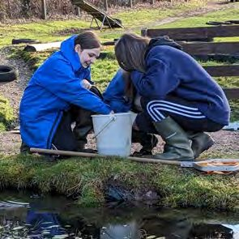
VALUE 04
Openness
We work openly with each other, and we are open and honest with students, schools and partners.
HOW IT SHOWS UP IN OUR WORK TOGETHER
HOW IT SHOWS UP IN OUR RELATIONSHIP WITH YOUNG PEOPLE
We work together, openly, with each other to deliver high-quality outdoor programmes…which means:
We are open and honest with students, schools and partners to achieve the best outcomes for young people…which means:
We share information with each other
When someone asks for help, you help them
We recognise that we want the same things, but may have different ways of achieving it
We use our meetings to share feedback
We actively provide regular and open feedback to each other, sharing successes and areas for improvement
When someone asks for help, you help them
We explain the activities and give young people a role in what we’re doing, and include them in the decision-making
We share information with schools, carers, and managers who are important to the young people to support their development
IN PRACTICE
IN PRACTICE
We are transparent with one another, sharing information about schools and students (as appropriate) that helps us to do our work better. We use our meetings to provide feedback and invite discussion.
We set up clear and agreed ways of communicating — with students, schools and parents. For DofE, advice and training are available as required. The Care Experience Team is about setting up clear, agreed routes for two-way communication with schools, carers and families that are “jargon-free” and ensure “important points are summarised and shared.” And at the Residential Centre, this involves explaining the programme and our thinking to students over the course of the week.
Blairvadach Outdoor Education Service | Openness
Notes:
Openness: We work openly with each other, and we are open and honest with students, schools and partners.

Slide 9
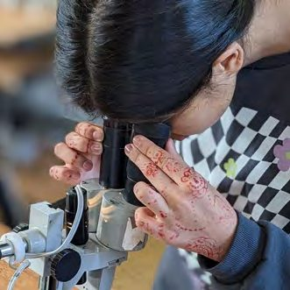
VALUE 05
Learning
We grow by ourselves and with others — and we put young people’s learning at the centre of everything we do.
HOW IT SHOWS UP IN OUR WORK TOGETHER
HOW IT SHOWS UP IN OUR RELATIONSHIP WITH YOUNG PEOPLE
We grow by ourselves and with others…which means:
We put young people’s learning at the centre of everything that we do…which means:
We make time for professional development and mentoring others
We demonstrate a commitment to building new skills and are willing to make changes in how we work, acknowledging that every journey is different
We share feedback and communicate with each other to promote learning
We acknowledge that every learning journey may be different and we will collaborate with the young person to find ways to achieve their learning objectives
We work to find flexible and adaptive ways to support everyone
IN PRACTICE
IN PRACTICE
We find ways to share learning with each other. This might be sharing (in a small or large group) a technique, session idea, or learning from a recent visit — normalising the idea that learning flows in all directions, not just from manager to staff. Or it might simply be keeping training up to date and finding opportunities to share learnings as part of the team’s wider personal development plans.
We actively encourage and engage young people to review and reflect to build their soft skills (meta skills) and progress their learning journey.
Blairvadach Outdoor Education Service | Learning
Notes:
Activities were varied each week and allowed children to appreciate the nature around them. — Teacher, Glasgow Urban Adventure Award

Slide 10
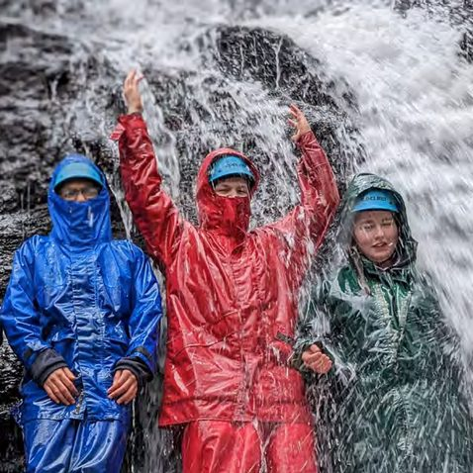
VALUE 06
Equity
We work to treat each other fairly — and every young person gets the same quality experience.
HOW IT SHOWS UP IN OUR WORK TOGETHER
HOW IT SHOWS UP IN OUR RELATIONSHIP WITH YOUNG PEOPLE
We work to treat each other fairly…which means:
We ensure every young person, regardless of background, ability, or need, has access to the same quality experience…which means:
We work to ensure we all follow the same standards, have similar opportunities, and have access to the same information, regardless of contract type or when we work
We do our best to ensure fairness between staff in how sessions, rosters, and development opportunities are allocated
We treat every young person as an individual while holding the group together, learning about each person in the group and what goes on inside
We strive to provide appropriate equipment for young people to do their activities safely
IN PRACTICE
IN PRACTICE
We work to engage across our service, seeking out opportunities to involve others and share learning where possible.
All young people have the same opportunities and have access to the same kit. A young person can arrive with the very best gear or no gear, and they will all get the same gear and be expected to participate in the same way.
Blairvadach Outdoor Education Service | Equity
Notes:
The excellent instruction staff provided the right amount of support and challenge to each child in their group. — Primary School Teacher, 2025

Slide 11
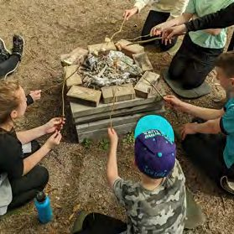
VALUE 07
Collaboration
We work across boundaries and teams — and we encourage young people to work together.
HOW IT SHOWS UP IN OUR WORK TOGETHER
HOW IT SHOWS UP IN OUR RELATIONSHIP WITH YOUNG PEOPLE
We work across boundaries and teams…which means:
We encourage young people to work together…which means:
We actively break down the barriers between full-time, part-time, and city centre staff, to support each other
We keep sight of the bigger goal — better outcomes for young people — and look for ways our work connects to it
We all involve the relevant people in decisions using jargon-free, two-way communication that respects what families already know about their children
We design activities that encourage young people to work together, supporting them to collaborate effectively
We engage all children to build a culture of collaboration and cooperation through all of our work together
IN PRACTICE
IN PRACTICE
We help each other out, recognising that we can’t do everything alone. At Pinkston, this might mean lending a helping hand when activities are under time pressure or supporting another group in undertaking their activities at the Residential Centre.
Activities and trainings are designed to involve all students in their activities, and where appropriate, the teachers and carers as well.
Blairvadach Outdoor Education Service | Collaboration
Notes:
They learn to express their ideas, listen to others, and negotiate roles in a way that fosters teamwork. — Teacher, Glasgow Urban Adventure Award

Slide 12

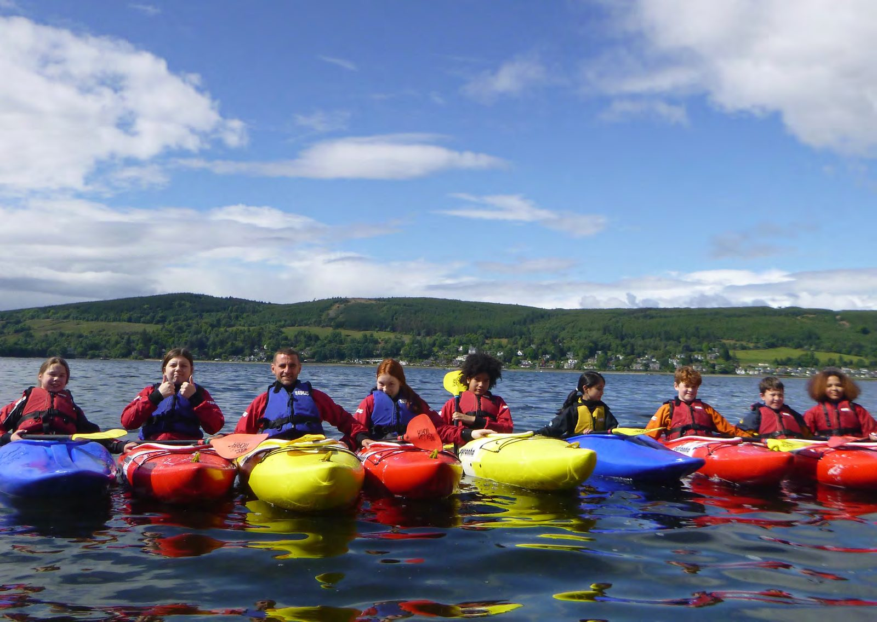
Our classroom is the outdoors.
Blairvadach Outdoor Education Centre
Rhu, Helensburgh, G84 8NN | 01436 820 491 | blairvadach.org.uk

